Slide 1
Distance and Time

Slide 2

By the end of this lesson, you should be able to:
Identify the units of distance and time
Recall how distance is measured
Recall how time is measured

Slide 3
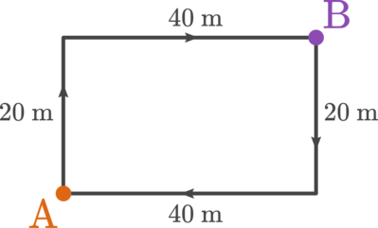
The distance an object travels is the amount of ground it covers.
For example, you may want to know the total distance you travel as you walk from home (point A) to school (point B). It's handy to have a map showing your path, like this:

Slide 4
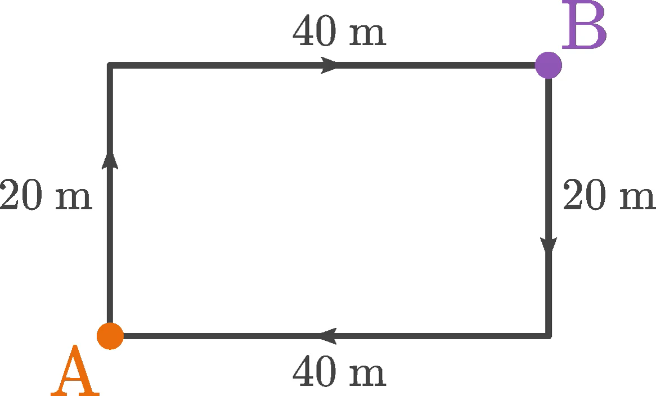
To find the distance between A and B, you need to add 20 m to 40 m. This means you covered a total distance of 60 m.
20 m+40 m=60 m

Slide 5
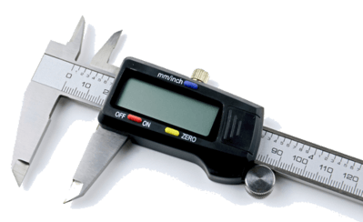
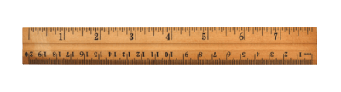
Distance is measured in the unit of metres (m). You can measure distances with a ruler, a measuring tape or if you need high precision, a digital caliper.
Distance is a scalar quantity. This means that the distance you walk has a size or magnitude, but the direction you walk in doesn't matter.

Slide 6

Perhaps the most important quantity in the study of force and motion is time.
Without the passing of time, nothing can move or change.
Time is always moving forwards.
Time only goes in one direction; forwards. It cannot travel backwards.

Slide 7
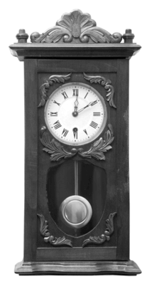
We use tools like clocks and calendars to measure it. The measurement of time is an extremely important concept for the rest of the work we will do in this module!

Slide 8
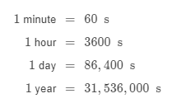
What units can time be measured in?

